Slide 1





Video Games:
Teach the Unimaginable
  Melanie A. Stegman, Ph.D.
  Director, Learning Technologies Program
  Federation of American Scientists
  Washington, DC, USA
MStegman@FAS.org
@MelanieAnnS
www.fas.org/blog/learningtech
National Institute of
Allergy and Infectious Diseases
Notes:
Melanie Stegman
1970 Born Cincinnati, OH
1987 Exchange student to Germany
1992 UChicago AB Political Science
2004 UCincinnati PhD Biochemistry
2005 Post doc Cornell Weill
2008 Project Manager, FAS
2009 Director, Learning Technologies, FAS
First kid in family to go to college
Driven but scared
Now determined to explain Molecular Biology to everyone so that science is not scary

Slide 2
Melanie Stegman, Ph.D.
Goals:
Make proteins as well understood as zombies.
Help average person appreciate the molecular science around them and in them.
Show the young and the curious how fantastic science and exploration really is.
Use games to teach abstract concepts.
Make a living making games.
Take over the world.
Currently funded projects:
Evaluate Immune Attack for teaching and confidence building efficacy.
Create the sequel to Immune Attack. A sequel that everyone can use, aligns with the teaching standards for 9th-10th grade biology, addresses adaptive and innate immune system and teaches core concepts of cellular and molecular immunology.

Slide 3
Video Games: Teach the Unimaginable to a really wide audience
Why Molecular Science education for the public?
Why Games?
Teach abstract concepts before misconceptions form
Young children can learn rules of “games” like grammar
Immune Attack, a third person shooter in the molecular world
Immune Attack increases knowledge, confidence
Game mechanics do not scare students away from topic
Developing Immune Defense
Scientific review and iterative game development process
Working from Core Concepts to game mechanics
Commercializing a Learning Game
Assumption: “Must replace some other commercial product”
Old Thinking: Must replace textbooks or console games
New: Replace casual games on phones, tablets or consoles
Notes:
Wide and diverse audience, Flow maintains motivation, etc.
Why use video games to teach?
*Games can introduce whole invisible worlds*
Scientist game developer creates a “conversation.”
What do games teach?
Spiral Curriculum
Teach younger students advanced concepts
Creating an accurate world.
How to present cells and molecules accurately
Game peer review
Evaluation.
How to test for intuitive learning?
DATA demonstrating learning and attitude increases

Slide 4
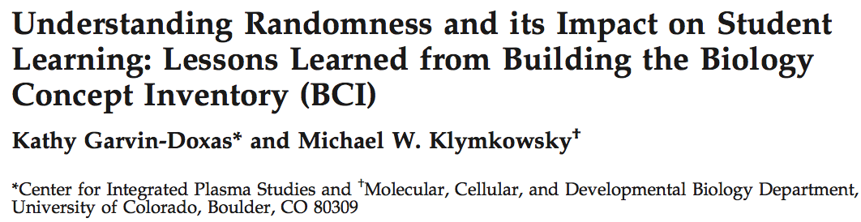
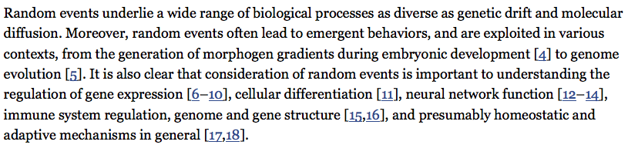
Misconceptions inhibit understanding science
Randomness is an example of a core concept that many college biology students do not understand
CBE–Life Sciences Education, 7:227-233. 2008
Notes:
How to teach molecular biology to the average person.
Average person: last biology class was in high school.
Tricky, because research shows that high schoolers leave high school and even leave their college level biology courses with Misconceptions!

Slide 5
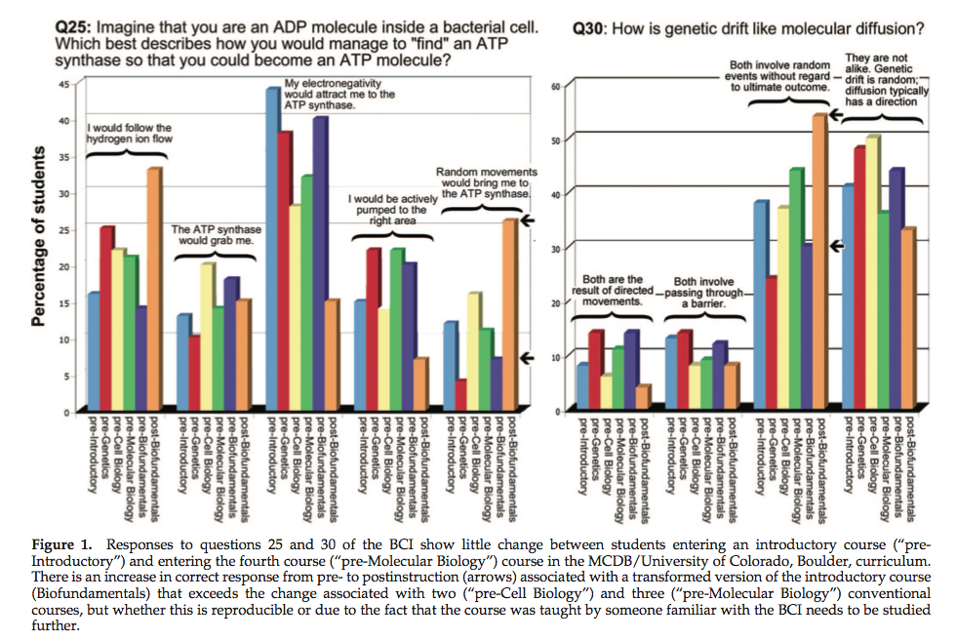
Misconceptions are difficult to change
Mike Klymkowsky et al. created a Biology Concept Inventory to test for how well college biology classes un-taught misconceptions.
Even second year biology majors are not applying random behavior of molecules in their thought processes.
I propose we teach such concepts to much younger students, before misconceptions form. This can be done, in game format.
CBE: Life Science Education. 7:227. 2008.
For more of this excellent research see
http://spot.colorado.edu/~klym/

Slide 6

Jerome Bruner
The Process of Education, 1960
Complex concepts can be learned by children as games, and teachers can use the game years later to explain formal ideas in science.
Grammar is his best example. Five year olds do not know what a verb is, but they still use them correctly.

Slide 7
Deep understanding of science
requires time to develop
Epistemological
Formal
Intuitive
…….Grade school …….……….. Middle School……..………….High School……..
Notes:
Concerns: Whether the correct concepts are actually being taught, whether younger children are confused by the concepts
Erin Fertig’s work. I want to make sure that the correct concepts are being taught. Iterative process of deciding what to present, making the game, testing for comprehension.
Intuitive understanding of how things work
Pacman, Donkey Kong, IA
Formal
Surge, Medical Mysteries (MedMyst)
Epistemological
HHMI, Scythe Experience

Slide 8
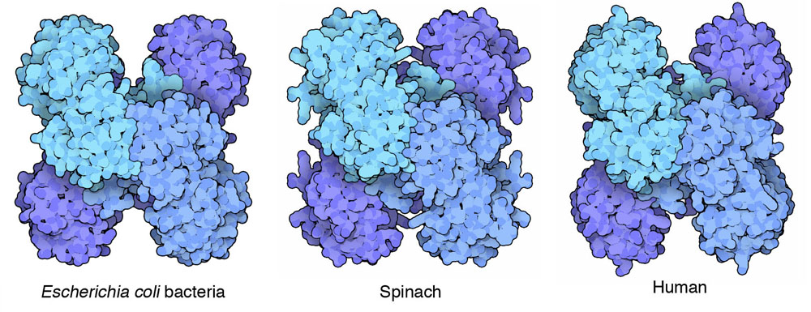
When the correct details are presented in an effective manner
Intuitive Understanding Is Possible
Image from
David Goodsell
The Machinery of Life

Slide 9

Portraying Molecular Motion Accurately
in Educational Videos
Excellent work is being done on how to present molecules accurately in educational images and videos. We have the technology to teach these concepts.
CBE–Life Science Education
11:103-110 2012

Slide 10
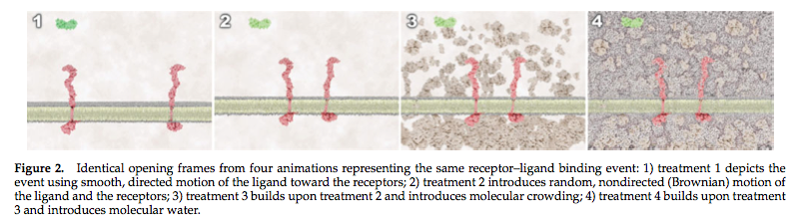
More complex may actually be more more effective at teaching
CBE–Life Science Education
11:103-110 2012

Slide 11
Video Games: Teach the Unimaginable to a really wide audience
Why Molecular Science education for the public?
Why Games?
Teach abstract concepts before misconceptions form
Young children can learn rules of “games” like grammar
Immune Attack, a third person shooter in the molecular world
Immune Attack increases knowledge, confidence
Game mechanics do not scare students away from topic
Developing Immune Defense
Scientific Review process
Working from Core Concepts to game mechanics
Commercializing a Learning Game
Assumption: “Must replace some other commercial product”
Old Thinking: Must replace textbooks or console games
New: Replace casual games on phones, tablets or consoles
Using the Video Game as an Assessment.
Player who uses wrong weapon looses faster in any game
Behind the scenes analysis possible, built in tricks
Notes:
Wide and diverse audience, Flow maintains motivation, etc.
Why use video games to teach?
*Games can introduce whole invisible worlds*
Scientist game developer creates a “conversation.”
What do games teach?
Spiral Curriculum
Teach younger students advanced concepts
Creating an accurate world.
How to present cells and molecules accurately
Game peer review
Evaluation.
How to test for intuitive learning?
DATA demonstrating learning and attitude increases

Slide 12
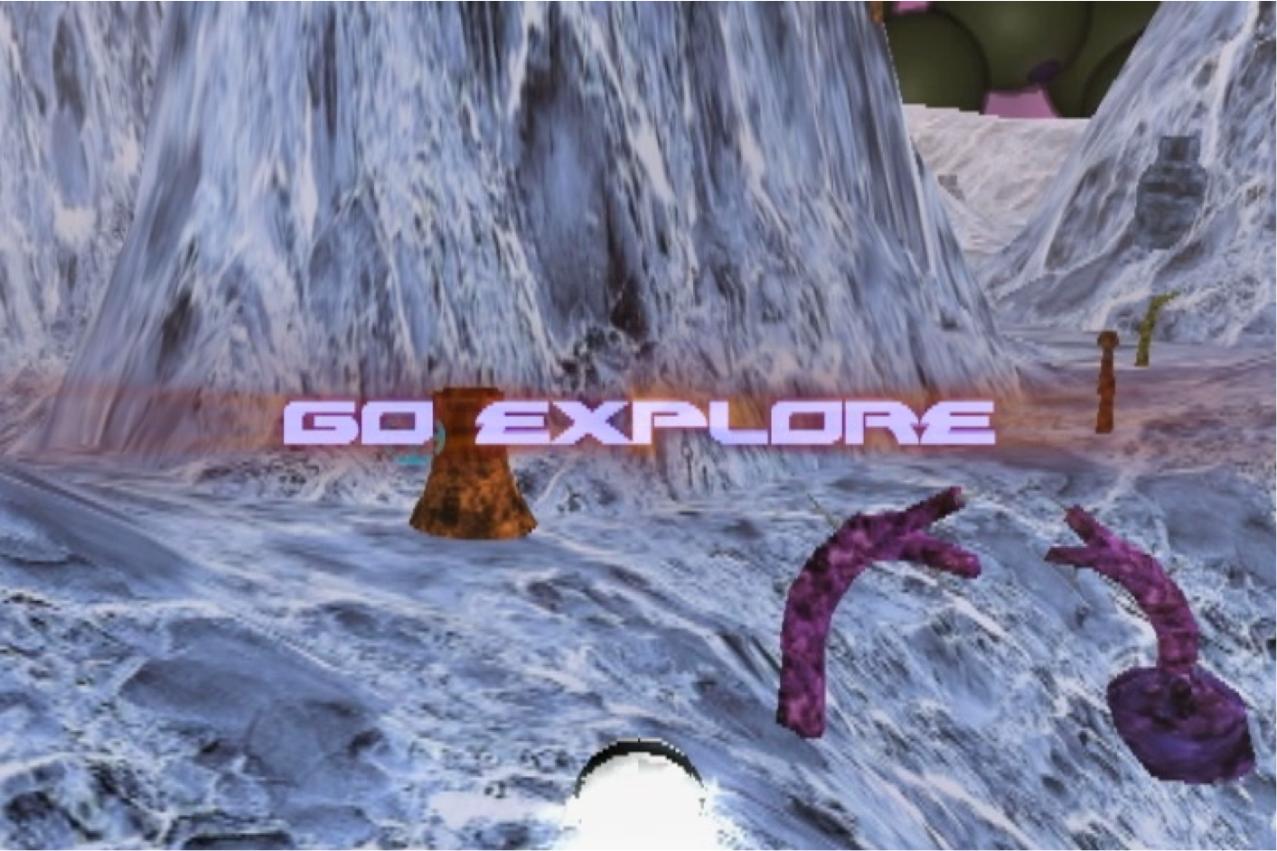
Immune Attack ImmuneAttack.org
watch trailer and download free game!

Slide 13
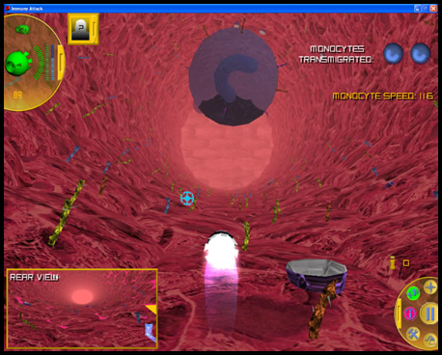

Slide 14
Immune Attack Team
Large education research project
requires a team of players.
Education/Curriculum Experts:
Volunteer Teachers and Professors
Science Advisory Group
Participating Schools:
McKinley Tech HS in Washington, DC and a list of teachers online who found us by searching for science games.
Outside Evaluation/Statistical Analysis Team:
Maine International Center for Digital Learning MICDL.org
University of Southern Maine
Game Developer:
Medical Illustrator/Game Designer Ion Medical Designs
Medical Illustrator/Game Designer Cosmocyte
Medical Illustrator/Molecular Graphics/3D Graham Johnson
Scientist/Evaluation Lead/Project Lead
Me

Slide 15

Evaluation of Learning and Confidence
Gains in Immune Attack Players
Data being prepared for publication and is not included in this presentation.

Slide 16
Immune Attack teaches students cell biology
Three Day Evaluation Protocol
7th -12 grade teachers register on our website.
Students are randomly assigned to the test group or the control group.
Week One
Students play Immune Attack OR the control game for 40 minutes.
Week Two
Students play Immune Attack OR the control game for 40 minutes.
The next day, students take online exam.
Notes:
----- Meeting Notes (7/28/12 15:22) -----
Short protocol
Quantitative data
Need a large N
Well Controlled because each class is split in half

Slide 17
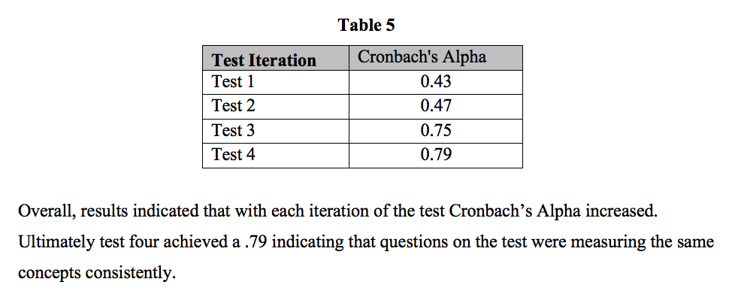
Two Years of Development
to create reliable test of Knowledge and Confidence

Slide 18
Conclusions
Immune Attack
is accurate science and is fun to play.
teaches vocabulary and concepts.
imparts confidence and familiarity with cells and proteins
Future:
Video games could be a very effective learning tool,
If they are designed by experts in the field,
If players receive a correct intuitive understanding, and
If intuitive knowledge is leveraged by consistent graphics and concepts in class and/or informal learning environments.
Notes:
Wide and diverse audience, Flow maintains motivation, etc.
Why use video games to teach?
*Games can introduce whole invisible worlds*
Scientist game developer creates a “conversation.”
What do games teach?
Spiral Curriculum
Teach younger students advanced concepts
Creating an accurate world.
How to present cells and molecules accurately
Game peer review
Evaluation.
How to test for intuitive learning?
DATA demonstrating learning and attitude increases

Slide 19
Video Games: Teach the Unimaginable to a really wide audience
Why Molecular Science education for the public?
Why Games?
Teach abstract concepts before misconceptions form
Young children can learn rules of “games” like grammar
Immune Attack, a third person shooter in the molecular world
Immune Attack increases knowledge, confidence
Game mechanics do not scare students away from topic
Developing Immune Defense
Scientific Review process
Working from Core Concepts to game mechanics
Commercializing a Learning Game
Assumption: “Must replace some other commercial product”
Old Thinking: Must replace textbooks or console games
New: Replace casual games on phones, tablets or consoles
Notes:
Wide and diverse audience, Flow maintains motivation, etc.
Why use video games to teach?
*Games can introduce whole invisible worlds*
Scientist game developer creates a “conversation.”
What do games teach?
Spiral Curriculum
Teach younger students advanced concepts
Creating an accurate world.
How to present cells and molecules accurately
Game peer review
Evaluation.
How to test for intuitive learning?
DATA demonstrating learning and attitude increases

Slide 20
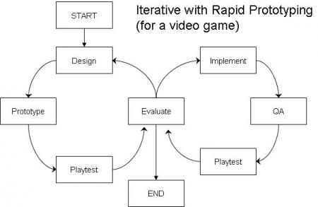
Modern Game Engines Allow Rapid Prototyping
Learning games require Evaluation by players as well as experts. So The evaluation step is even more important to repeat as often as possible, especially early on in game design.
And
http://gamedesignconcepts.wordpress.com by Ian Schreiber

Slide 21
Game Design Principles… A Game’s Mechanics create its Meaning
….and Meaning Is What It Teaches.
“Ultimately, designers need to recognize that a game’s theme does not determine its meaning. Instead, meaning emerges from a game’s mechanics – the set of decisions and consequences unique to each one. What does a game ask of the player? What does it punish, and what does it reward? What strategies and styles does the game encourage? Answering these questions reveals what a game is actually about.”
Soren Johnson
Developer for Spore speaks and writes about Game Design
Soren is a design columnist for Game Developer Magazine. His thoughts on game design are at
www.designer-notes.com

Slide 22

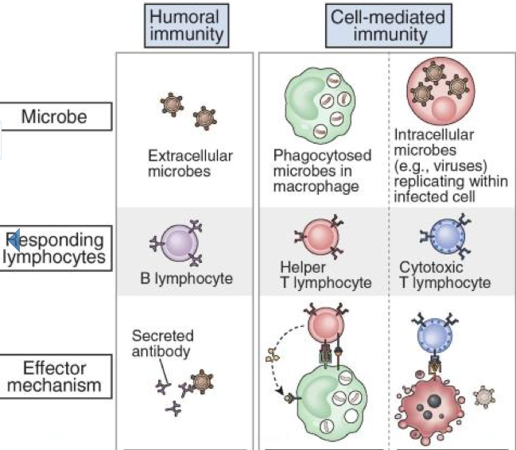

Find a good basic textbook
Andrew Lichtman
Abul Abbas
Saunders, Elsevier

Slide 23
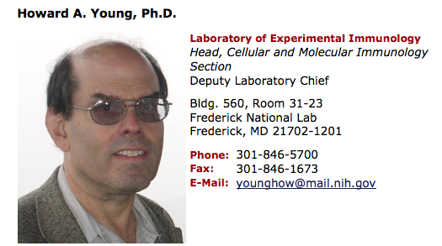
Science Advisory Group
Others include
Maria Santore
Department of Polymer
Science and Engineering
University of Massachusetts, Amherst
William A. Muller, MD, PhD
Magerstadt Professor and Chairman
Department of Pathology
Feinberg School of Medicine
Northwestern University
My PhD advisor, committee members, friends…
40 member “Science Advisory Group” is proud to have their names associated with our game, and a line for “outreach” on their CV.
Called us asking to help, has recruited his colleagues, answers crazy theoretical questions such as “How many E. coli can one macrophage eat?” What if a macrophage eats a Neutrophil that has a Listeria bacterium inside it…?”

Slide 24

Immune Attack 2!
Three Dimensional Fantastic world of proteins, lipids and sugars organized into cells that work together through signals and are ruled by a harsh DNA overlord.
We began the work of aligning our Learning Objectives with our game design, and pushing our technology further to match our ambitious goals.
Main technological hurdle:
Presentation of accurate proteins in game engine. We want a lot of proteins, each one has 1000’s of atoms = 10000’s of polygons.
Embedded Python Molecular Viewer (ePMV; Johnson et al., 2011), BioBlender (Andrei et al., 2010), and the software toolkit Molecular Maya (mMaya; McGill, in preparation).
IA2 team Ken Coulter of Ion Medical Designs
With Graham Johnson

Slide 25
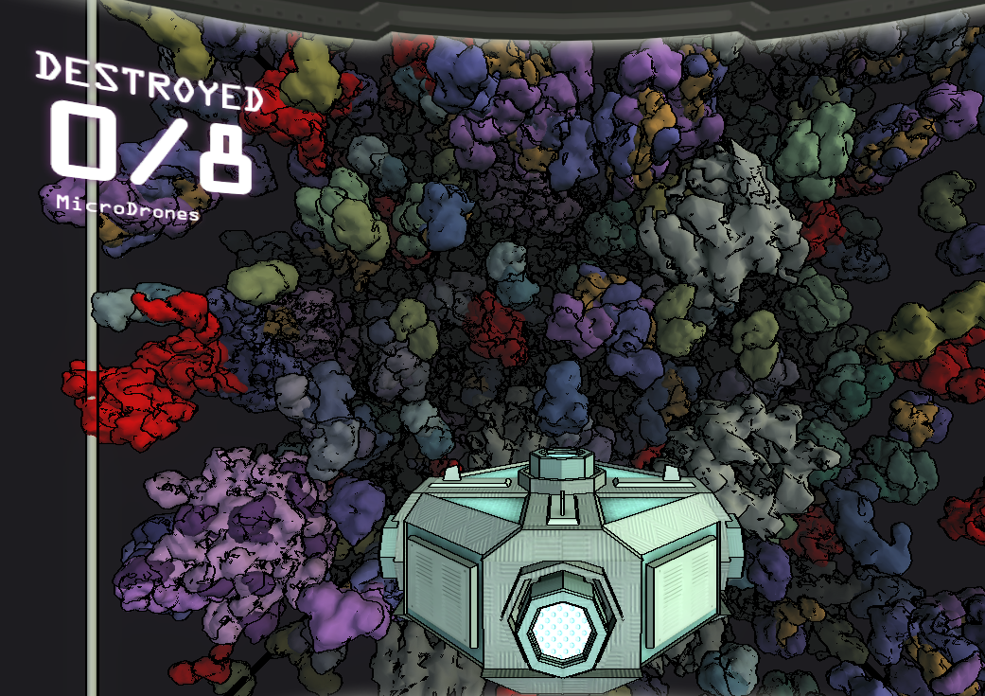
Presenting Realistic Proteins in the versatile Unity Game Engine

Slide 26
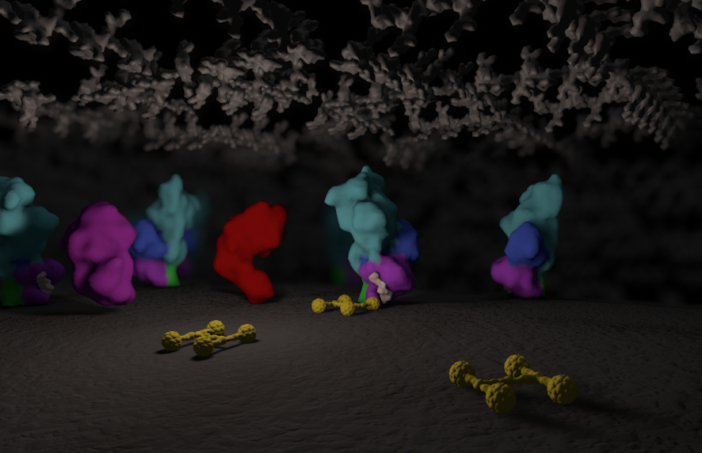

Immune Attack 2
Scene by Ken Coulter with Melanie Stegman and Graham Johnson

Slide 27
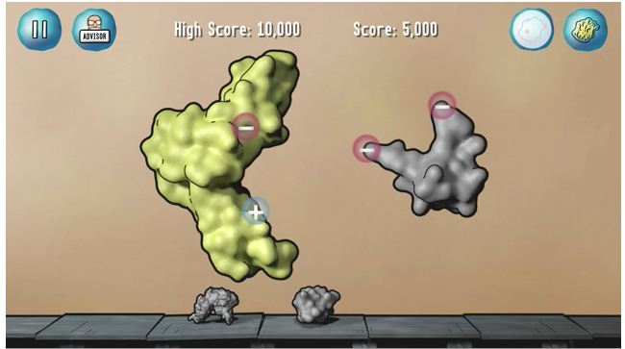
Immune Attack 2
Presents core concepts of biochemistry and cell biology as if they are rules of the game: Structure/Function relationship of proteins, interactions and regulated activities of proteins, and gene regulation and its effect on
Mini game inside allows players to build their own “weapons” (yes, just like Bioshock!)
The weapons are antibiotics or other proteins… Just like Bonnie Scott, Ph.D.’s game design document: Cell Machines…
Basically, IA2 game design
  requires players to use core concepts to build “weapons” and
  requires players to experiment just like cell biologists do, by “knocking out” a protein and observing the effect….
https://vimeo.com/45309635

Slide 28
Iteration Iteration Iteration Iteration Iteration Iteration
So along the way we realized our plan was to much for the funding and time… so we chose a set of learning objectives and focused on them.
Iteration!
http://gamedesignconcepts.wordpress.com by Ian Schreiber

Slide 29

Immune Defense
Meet our new game:
Learning Objectives
Randomness of molecular diffusion
Specificity of interactions between protein signals and protein receptors
Low and high affinity interactions are different
Cells have specific functions because of their unique complement of proteins
Cells can signal to each other
Cells respond to their environment if they have the correct receptors
Regulating which proteins you have on hand is important for cell function
Pathogens have evolved to thwart our immune system

Slide 30
New game design should get all the immune cells into the game!
Andrew Lichtman
Abul Abbas
Saunders, Elsevier
Notes:
----- Meeting Notes (7/28/12 15:28) -----
Wanted to get all the 7-10 white blood cell types into the game
Wanted to address a set of learning objectives that were more like strategy and protein regulation than 3D structure..... Changing LO caused change in Game

Slide 31
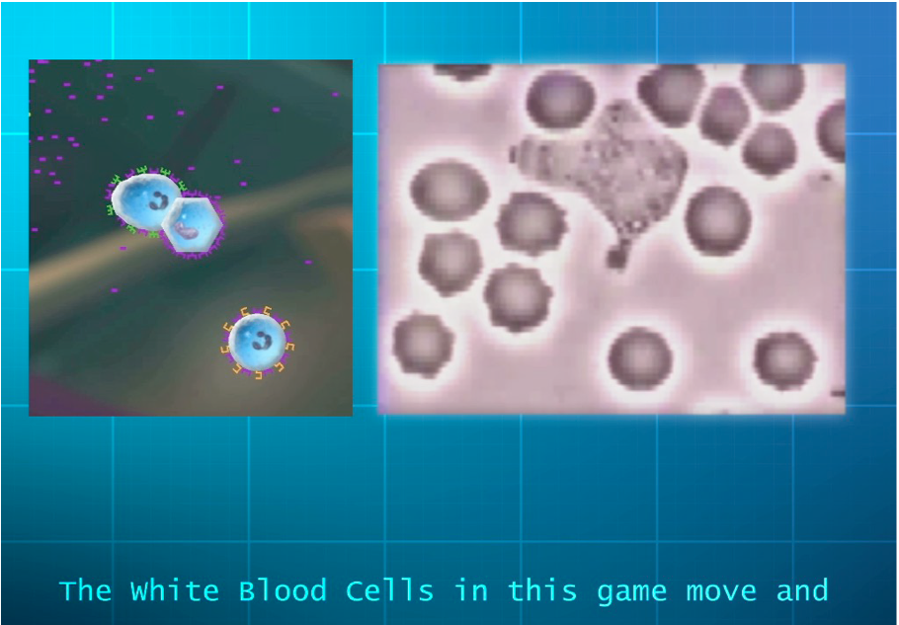
Immune Defense Trailer
www.fas.org/blog/learningtech/immune-defense-beta-testing
Playtest our super rough demo version and see the video for yourself….
Notes:
Real Time Strategy
Is a simulation created by the Microbot’s artificial Intelligence
Player controls a Microbot remotely
has molecule moving power
has protein regulating power
Ever more crafty Pathogens
Ever more capable and cooperative White Blood Cells

Slide 32
Immune Defense
Learning Objectives
Randomness of molecular diffusion
Specificity of interactions between protein signals and protein receptors
Low and high affinity interactions are different
Cells have specific functions because of their unique complement of proteins
Cells can signal to each other
Cells respond to their environment if they have the correct receptors
Regulating which proteins you have on hand is important for cell function
Pathogens have evolved to thwart our immune system

Slide 33
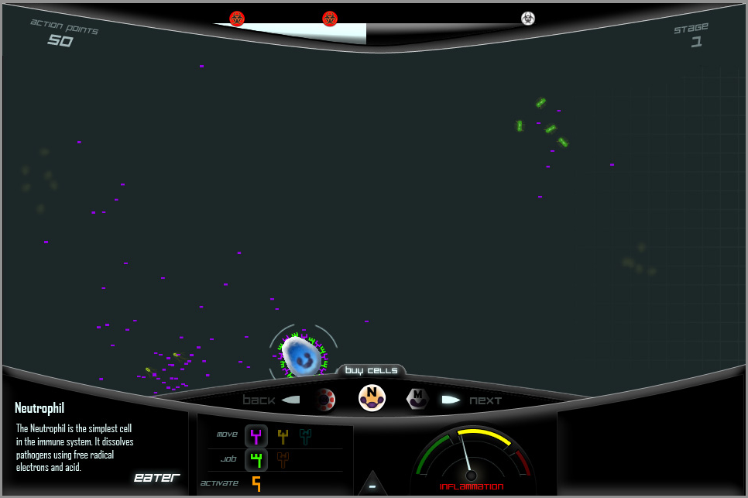
Immune Defense Interface Style
This fantastic concept art by Cosmocyte Technical Director, Alec Slayden
Notes:
What I’ve learned… Project Lead.
Work with a professional production company to direct production of a game that preserves
Making our ID game design doc: 40 slides on power point and 10 word doc pages. But still it was do able. Where AI2 was not defined enough to start making. Cameron
Show learning objectives 1 minute total
Hop out and play the game.

Slide 34
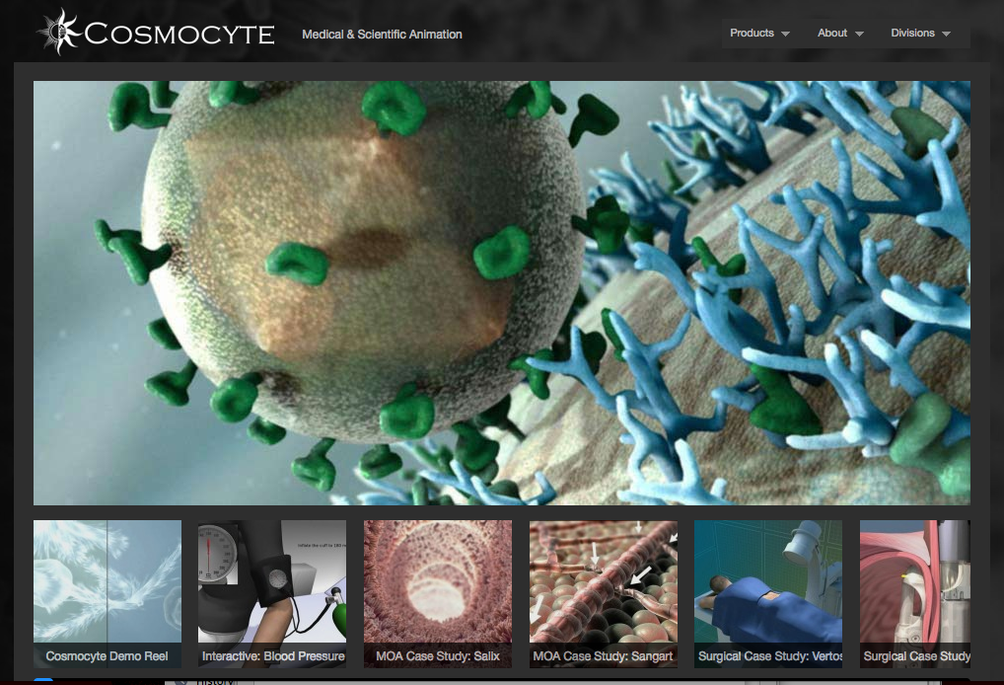
Immune Defense Development Team
www.cosmocyte.com

Slide 35
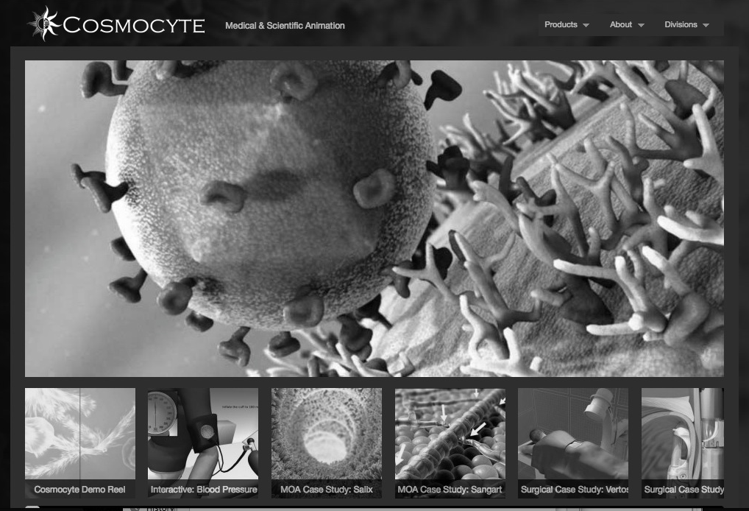
Immune Defense Development Team
Cosmocyte
Cameron Slayden, CMI
Alec Slayden, Technical Lead
FAS
Melanie Stegman, Ph.D.
Project Lead, Writer,
Designer, Lead Scientist
With
Ohad Frenkel, Programmer
Graham Johnson, Common Sense
Bonnie Scott, Brains for Storming

Slide 36

Go right now and review science games!
Teachers: Help out your fellow teachers,
Scientists: Share your scientific expertise,
Players: Make sure the best games are rated high!
ScienceGameCenter.org
Brought to you with love for games and science by
The Federation of American Scientists

